Slide 1
Hack Košice 4B
Team SUDO is bLoAt

Slide 2
CONTENTS
How can we make the lectures more interesting for students?
Introduction
Gathering data
Conclusion
Achieving interactivity
Another more raw ideas
Teaser parts
Submitting feedback
Catalogue of lecturers

Slide 3
HOW CAN WE MAKE THE LECTURES MORE INTERESTING FOR STUDENTS?
Introduction
The power point has become a great tool that is used in every lecture you can think of. It can pack up many information in nice neat presentation. The problem is that instead of sending the notes to the student trying to comunicate with them, they are focused on writing rather than being actively joined in the lecture.

Slide 4
GATHERING DATA
We made a simple questionarry containing 8 school subjects and told our schoolmates to rank them from best to worst (eight best, one worst). The result went like this:

Slide 5
GATHERING DATA
In this graph we also ordered the subjects by practicality, how much practise is on the lecture.

Slide 6

Findings
Data shows that the three most favourite subject are also the most practical ones.
This means that students like when there is more activity/interactivity on the lecture

Slide 7
How to achieve practical/interactive lectures
Show real world examples instead of telling lot of theory
Good example would be if you want to show students how to protect against malware I would suggest, trying to install some dummy virus and block it, or even make students do it, this way they will enjoy it, and they have better chance of remembering it.
Encourage student participation
Force discussions, make student anticipate in lecture

Slide 8
ANOTHER MORE RAW IDEAS

Slide 9

SHOW TEASER PARTS OF LECTURES ON THE INTERNET
Some of the lectures would be recorded on camera and shared on social media or website to showcase/promote lectures from the organization

Slide 10

SUBMITTING FEEDBACK
How do we ensure that a student will keep submitting feedback on the lectures even after he attended many of the lectures?
If students answers the questions truthfully and fills all open ended questions they will have a chance to win some small prizes

Slide 11
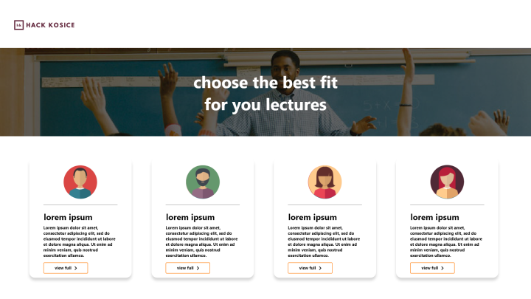
CATALOGUE OF LECTURERS
Create a website with list/catalogue of lectures so that shcools can choose which person fits for them the most
Students could also make a review about the lecturer and rate his lecture

Slide 12
Thanks World!
Thanks for reading our presentation, we hope it helped your

